Slide 1
Unit 201: Health and safety in building services engineering
Access equipment

Slide 2
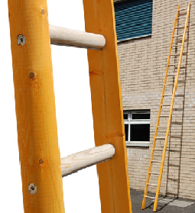
Ladders
Pole ladders
Used to access scaffolds.
Can be up to 12m in length.

Slide 3
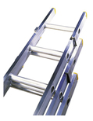
Ladders
Extension ladders
Extension – or multi-section – ladders are split into sections which can be extended to reach the required height.

Slide 4
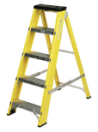
Ladders
Step ladders
These are used mainly for indoor work but can also be used outside, as long as they are standing on a firm base.

Slide 5
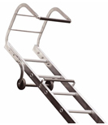
Ladders
Roof ladders
For use on sloped roofs.
Must be accessed from a scaffold, not a ladder.
Hooked end prevents the ladder slipping down the roof.

Slide 6
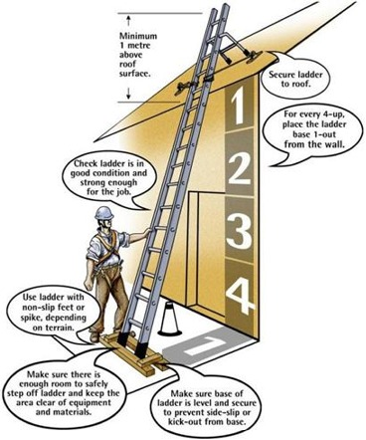
Using ladders safely
Should be inspected before every use.
Only be used on firm, hard ground.
Don’t raise a heavy ladder on your own.
Ladders should stand at an angle of 75° – ratio of 1:4 (1 out for every 4 up).
Ladders over 3m long must be secured.
Otherwise, the ladder must be ‘footed’.
Should extend at least 5 rungs (or 1.07m) above the landing platform.
Never overreach.

Slide 7
Pre-use checks
Does the ladder/step ladder have any of the following?
Missing, damaged or worn anti-slip feet on metal and fibreglass ladders/step ladders (essential for good grip).
Items stuck in or adhered to the feet, such as stones, grease, dirt or other debris, preventing the feet from making direct contact with the ground.
Mud, grease, oil or wet paint either on the rungs, stiles, steps or platform.
Cracks, splits, bends or warps in the rungs, stiles, steps or platform.
Missing, broken or weakened rungs or steps.
Missing or damaged tie rods.
Cracked or damaged welds, missing or loose screws or rivets, corrosion, sharp edges, dents.
Painted surfaces.

Slide 8
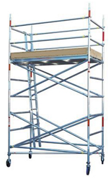
Tower scaffolds
A tower scaffold is one way to prevent a fall when working at height. The type of tower selected must be suitable for the work and erected and dismantled by people who have been trained and are competent to do so in compliance with PASMA (Prefabricated Access Suppliers’ and Manufacturers’ Association).
Those using tower scaffolds should also be trained in the potential dangers and precautions required during use.
The manufacturer, supplier or hirer has a duty to provide an instruction manual explaining the erection sequence, including any bracing requirements.

Slide 9
Tower requirements
Tubes must be straight.
Tubes and fittings must be undamaged and free from corrosion.
The ground on which the scaffold is placed must be firm and even.
Base plates must be used. Adjustable base plates can be used on ground which has different levels.
Sole plates must be used to provide even weight distribution if the tower is to be used on soft ground.
Foot ties or plan bracing must be fitted as low as possible.
Working platforms must be close boarded.
Overhang boards must not exceed four times the thickness of the boards and must not be less than 50mm past the support.
Working platforms higher than 2m must have toe boards fitted at least 150mm high and guard rails between 920mm and 1,150mm high.

Slide 10
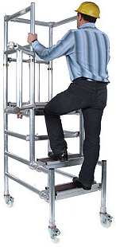
Other access equipment
Podiums
Podium steps are much better than step ladders; they offer trouble-free and secure access to ceilings and walls, and reduce the odds of falling from just a metre.

Slide 11
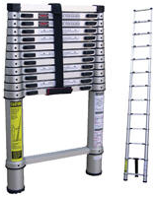
Other access equipment
Telescopic ladders
One version is just 780mm when closed but stretching to 3.3m when extended.

Slide 12
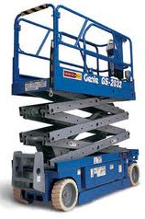
Other access equipment
Mobile scissor lifts
A scissor lift is a type of platform that can usually only move vertically.

Slide 13
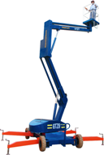
Other access equipment
Cherry picker
A cherry picker (also known as a boom lift, man lift, basket crane or hydraladder) is a type of aerial work platform that consists of a platform or bucket at the end of a hydraulic lifting system.

Slide 14
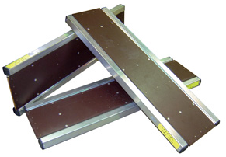
Other access equipment
Crawling boards
Crawl boards are designed to be lightweight but very robust. They will enable operatives to work safely within loft spaces.

Slide 15
Unit 201: Health and safety in building services engineering
The End

